Slide 1

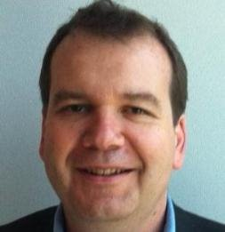




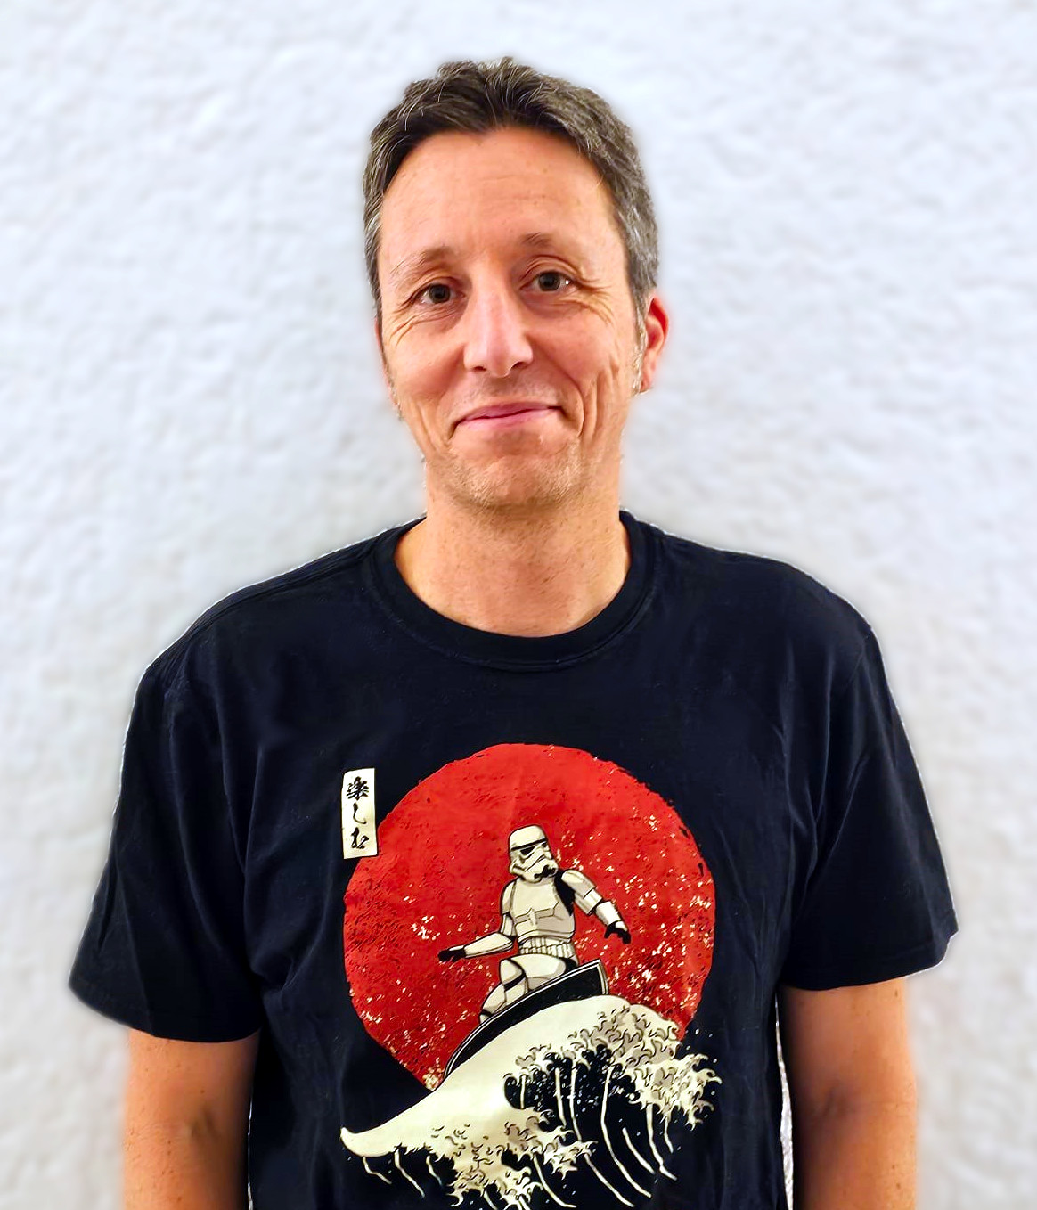
EMEA | EPS
FY27 EMEA EPS — Fabric Apps Motion
Two paths to Microsoft Fabric, enabled through “Micro Hack”
EMEA · Owner: EPS Tech / GTM · Two micro-hacks: Apps (Rayfin) + Workloads (Extensibility Toolkit)
EMEA PSA Data & Apps Team
July 2026
EMEA | EPS

Slide 2

Executive Summary
One motion, two execution paths — both powered by a single, repeatable vehicle: the “Micro Hack”.
🗄️
Path A — Apps
🧩
Path B — Adoption
System Integrators / Advisory
ISV
Outcome we drive
Outcome we drive
Build & ship business apps on Microsoft Fabric with Rayfin — partner-led, on governed OneLake data.
Every managed ISV embeds a Fabric workload in its offer — so every customer consumes a data workload.
PRIMARY KPI # of opportunities created (MSX)
PRIMARY KPI % of managed ISVs that built a workload
The core idea Microsoft does not build new tooling — Fabric, Rayfin, the Extensibility Toolkit and the GitHub Copilot CLI already exist. We package one turnkey, repeatable vehicle — the “Micro Hack” — that an SI or ISV can run themselves.
FY27 EMEA EPS · Fabric Apps Motion — the “Micro Hack”
EMEA | EPS
2

Slide 3
The Motion at a Glance
“We build it, the partner repeats it.” — one operational vehicle, two partner paths.
⚡
Path A — SI / advisories
⚙️
repeat the Micro Hack with their own customers
Micro Hack
KPI # opportunities (MSX)
Microsoft EPS
1 day · repeatable
builds the kit + reference scenarios
Morning — Content why Fabric · Rayfin · MFE
Path B — ISV
embed a Fabric workload → every customer adopts
Afternoon — Build scenario in → app / workload out
KPI # workloads per ISV
Operating principle For every FY27 EPS motion we ship a highly operational vehicle (here: the Micro Hack). Microsoft builds and co-delivers the first run; the partner then owns and repeats it.
FY27 EMEA EPS · Fabric Apps Motion — the “Micro Hack”
EMEA | EPS
3

Slide 4
Strategic Context — the simplified “why now”
Enough to open a customer conversation, no more — the one-slide version of the narrative.
60%
83%
+95.6%
+46%
of AI projects without AI-ready data will be abandoned
of leaders say stronger data infrastructure would speed AI adoption
higher win rate when an opportunity is shared with a partner
larger deal size when a partner is attached
Gartner
Accenture
Partner effect
Partner effect
Apps are the new compelling event. AI-era apps demand governed data. Fabric + Rayfin remove months of backend plumbing, so partners ship on OneLake — governed by default — instead of rebuilding infrastructure.
⏰
Three customer frictions to anchor on:
1. Stay ahead of AI-era security & governance
2. Cut the cost & time of backend plumbing
3. Unblock AI innovation on governed data
🛡️
🗄️
🧠
FY27 EMEA EPS · Fabric Apps Motion — the “Micro Hack”
EMEA | EPS
4

Slide 5
Path A — SI / Advisory (Apps)
Focus: Enable partners to build & ship customer business apps on Fabric, partner-led.
🎯
Objective
📈
Primary KPI
Enable SIs to build and ship business apps on Microsoft Fabric with Rayfin, led by the partner — on governed OneLake data.
Number of opportunities created in MSX (partner-sourced or partner-shared) — ACR vision.
🔄
Secondary KPIs
👤
Lead role
# of “Micro Hack” days repeated by the partner
# of apps deployed to Fabric · Azure/Fabric pipeline.
EPS (PDM / PTS / PSA), with one executive sponsor per SI
FY27 EMEA EPS · Fabric Apps Motion — the “Micro Hack”
EMEA | EPS
5

Slide 6
The Vehicle — Micro Hack 1 (Apps) agenda
A fixed, repeatable one-day format. Microsoft co-delivers run #1; the SI repeats runs #2…N independently.
☀️
MORNING — Prez + Demo
🤖
AFTERNOON — Build + Demo
1
Why build on Fabric managed backend · governance on OneLake · time-to-app
5
Build sprint 1 scaffold, declare the data model (Rayfin provisions the DB), core screens
2
Rayfin foundations data model = database · auth, APIs, hosting · deploy in one command
6
★ Build sprint 2 extend, polish, deploy to Fabric (rayfin up), demo
3
Demo Helios Bicycle Studio built live with the GitHub Copilot CLI
7
Plan & next steps turn the app into an MSX opportunity + a 90-day plan
4
Plan the build pick the scenario · data model · screens · roles
★
The afternoon is the differentiator. Teams ship a real working app on Fabric — the artifact the SI uses to open and qualify a real opportunity.
FY27 EMEA EPS · Fabric Apps Motion — the “Micro Hack”
EMEA | EPS
6

Slide 7
Repeatability — the partner runs its own Micro Hack
The motion only scales if the partner repeats it without us. We ship a “Micro Hack in a Box”.
📖
🤖
👥
📈
Facilitator kit
Copilot CLI access
Train-the-trainer
Repeatability KPI
Slide deck (morning), demo script, timing guide, FAQ
A guided way to build the app / workload with the GitHub Copilot CLI
Run #1 co-delivered; we certify a partner pursuit team
# of partner-led sessions and opportunities they generate (MSX)
How it scales
⚙️
🤝
🔄
🎯
Microsoft EPS
Co-deliver Run #1
Runs #2…N
Opportunities
Build kit + scenarios + facilitator pack
Train-the-trainer with the partner team
Partner delivers independently to its customers
Apps & workloads → created / shared in MSX
FY27 EMEA EPS · Fabric Apps Motion — the “Micro Hack”
EMEA | EPS
7

Slide 8
The Micro Hack kit — the one asset we build
A reusable enablement kit, not a product — used live in the day, then repeated by the partner.
It IS
It is NOT
✓
A ready-to-run kit: prompts, scripts, reference code
✕
A new product or platform
✓
Two scenarios — a Rayfin app and a Fabric workload
✕
A replacement for Rayfin / the Extensibility Toolkit
✓
Facilitator materials to repeat the day
✕
A one-off custom build for a single customer
INPUT — Fixed scenario
BUILD — Copilot CLI + Rayfin / Toolkit
OUTPUT — Working app / workload
Brief + sample data + target users
Apps: Helios · Workloads: GreenGrid
Same start for every run
Scaffold, declare data model / workload
Screens, roles, OneLake read (OBO)
Validate: build + tests green
Deployed to Fabric, governed
Demo-ready, partner-owned
Artifact → opportunity / adoption
FY27 EMEA EPS · Fabric Apps Motion — the “Micro Hack”
EMEA | EPS
8

Slide 9
Path B —ISV (Workloads)
Grow the Fabric footprint through ISV offers: embed once, consume mechanically across the ISV’s customer base.
Embed once → adopt mechanically
Objective
Microsoft-managed ISV
Get every Microsoft-managed ISV to embed a Fabric workload (Extensibility Toolkit) inside its commercial offer — so every time a customer uses the product, a Fabric data workload is consumed by design.
Embed a managed Fabric workload (Toolkit)
Embed once, adopt many. When an ISV standardizes on a Fabric workload, its entire customer base becomes ongoing Fabric adoption.
ISV product / offer
Customer 1
data workload
Customer 2
data workload
Customer N
data workload
PRIMARY KPI % of managed ISVs that built a Fabric workload
Growing Fabric footprint — adoption & ACR
Measured on adoption & mechanical consumption — not repeated workshops. The win is the embed and the footprint it generates.
FY27 EMEA EPS · Fabric Apps Motion — the “Micro Hack”
EMEA | EPS
9

Slide 10
The Vehicle — Micro Hack 2 (Workloads) agenda
Same fixed, repeatable shape as Micro Hack 1 — but the artifact is a Fabric workload the ISV embeds in its offer.
☀️
MORNING — Prez + Demo
🤖
AFTERNOON — Build + Demo
1
Why build a workload reach every Fabric customer via the Workload Hub · run on OneLake
5
Build sprint 1 clone toolkit, Setup.ps1 (Entra app), dev server + gateway, Hello World, CreateNewItem
2
Extensibility Toolkit workload structure · Entra app · Dev Gateway · manifest · OBO token
6
★ Build sprint 2 read Files/sites.csv from OneLake, call the backend, render the scorecard
3
Demo GreenGrid Scorecard running live inside Fabric
7
Plan & next steps embed in the ISV offer + path to publish on the Workload Hub
4
Plan the build pick the workload · OneLake data · backend call · UI
★
Same shape, different artifact. The output is a Fabric workload the ISV embeds in its offer — so every customer adopts Fabric by design.
FY27 EMEA EPS · Fabric Apps Motion — the “Micro Hack”
EMEA | EPS
10

Slide 11
What we reuse — we don’t rebuild
Everything below already exists. The motion packages it; the Micro Hack runs it.
Building blocks
⚙️
Build map
Microsoft Fabric OneLake · governance · single copy of data
1
Reuse — don’t rebuild
Rayfin managed backend for business apps (data model = DB)
Scaffold
2
create-rayfin / Setup.ps1
Fabric Extensibility Toolkit build native workloads, distributed in Fabric
Data
3
rayfin data (model = DB) / sites.csv
Run
GitHub Copilot CLI build apps & workloads fast, with validation
npm run dev · Dev Gateway
4
Deploy
Workload Hub distribute a workload to every Fabric customer
rayfin up · Hello World item
5
Publish
Workload Hub
FY27 EMEA EPS · Fabric Apps Motion — the “Micro Hack”
EMEA | EPS
11

Slide 12
KPIs — how we measure the motion
Two scoreboards, one north-star: the share of apps and workloads that are partner-led, not Microsoft-led.
🗄️
Path A — Apps
🧩
Path B — Workloads
Primary KPI
Primary KPI
# of opportunities created (MSX), Stage 1 & 2
% of managed ISVs that built a Fabric workload
Secondary
Secondary
# Micro Hacks repeated by the partner
# apps deployed · Fabric / Azure ACR pipeline.
# workloads per ISV · Fabric usage / ACR from ISV end-customers.
North-star The share of Micro Hacks, apps and workloads that are partner-led, not Microsoft-led — the motion is healthy when partners repeat it without us.
FY27 EMEA EPS · Fabric Apps Motion — the “Micro Hack”
EMEA | EPS
12

Slide 13
Execution Roadmap — FY27
Microsoft FY starts in July. End of Q1: kit in the partner’s hands — the motion shifts from MS-build to partner-led repeat.
Q1 · Jul–Sep ’26
Q2 · Oct–Dec ’26
Q3 · Jan–Mar ’27
Q4 · Apr–Jun ’27
Build — kit + facilitator pack
Build — reference scenarios
Path A — Sponsor + pursuit team
Path A — Co-deliver Run #1 ◆
Path A — Frontier SIs repeat (own customers)
Path A — Scale to other SIs
Path B — ISV first workloads
Path B — Repeat across portfolio
◆ Key milestone — Run #1 co-delivered, end of Q1 (Sep ’26): first Micro Hack delivered live; partner pursuit team certified. Q2–Q3: partners repeat independently while we scale to other SIs and ISVs.
FY27 EMEA EPS · Fabric Apps Motion — the “Micro Hack”
EMEA | EPS
13

Slide 14
The Ask
Align this motion as the execution layer for building apps & workloads on Fabric — not a parallel track.
👤
💵
🤖
🔗
Sponsorship
Funding
Workloads PM
ONE Microsoft
Ahmed + EPS leadership behind ONE-Microsoft motion
Build the kit + scenarios and run the first co-delivered sessions
(Lunch $$$ ☺)
Align with the Extensibility Toolkit roadmap and the Workload Hub
ISV + Advisory → one execution layer, not parallel tracks
FY27 EMEA EPS · Fabric Apps Motion — the “Micro Hack”
EMEA | EPS
14

Slide 15
EMEA | EPS
We build it. The partner repeats it.
One motion · two paths · one repeatable vehicle — the “Micro Hack”.
EMEA | EPS

